Slide 1
Integrity in Research
Sophie Nicole
CRCN Inserm

Slide 2
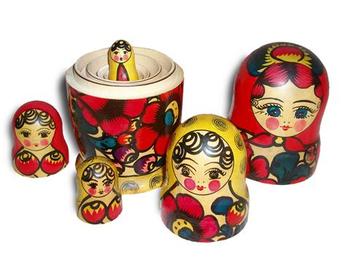
Russian dolls…
Research Integrity
Behaviors of researchers that may hamper validity of research or trust in science
Research Ethics
Consideration on the use of animals or humans in research
Responsible Research
Consequences of research for society and environment

Slide 3
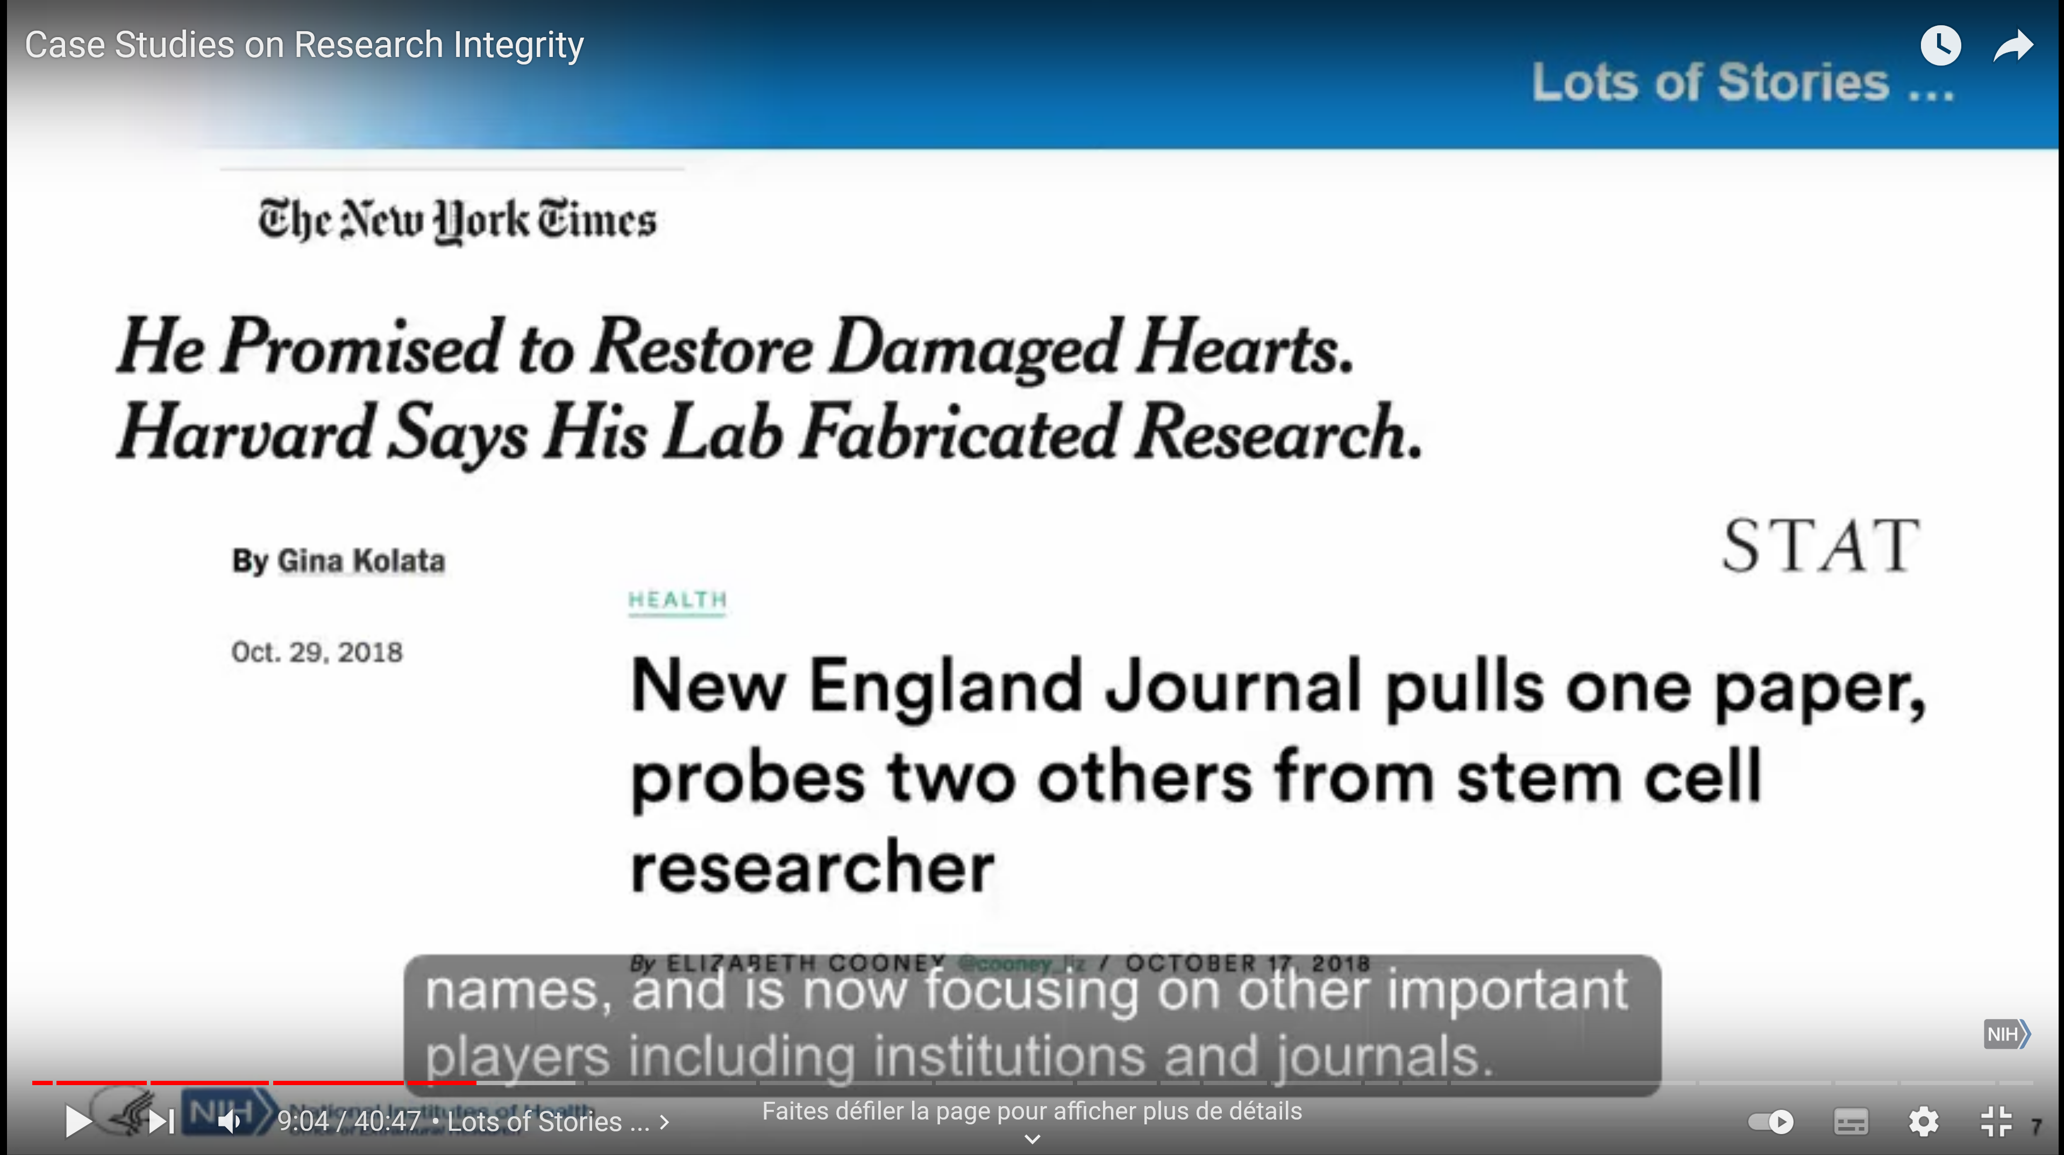
From an institutional problem…
Case studies on Research Integrity, Dr M Lauer
May 2019 » The Role of Research Integrity in Promoting Excellence: Tools for Colleges and University Leaders”
https://youtu.be/ZKwpe77iZws?t=509

Slide 4
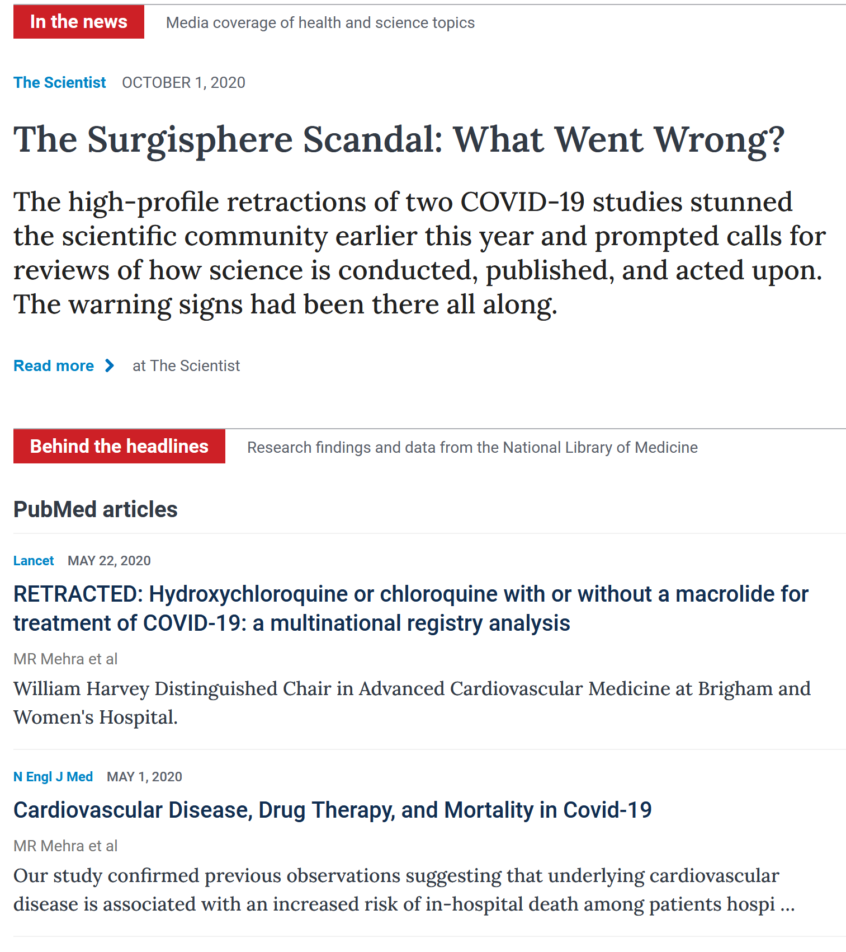
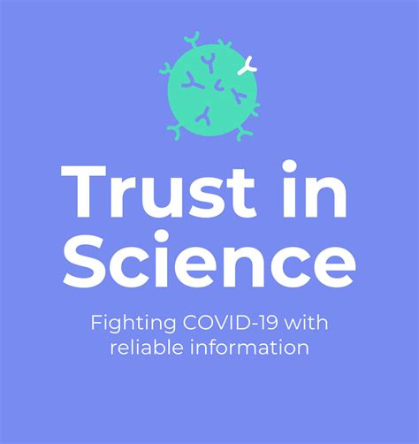
…to a societal concern
Research Integrity, Ethics, Governance, and the "New Normal“, Dr Simon Kolstoe
Epigeum Webinar, 2021
https://youtu.be/OGPiisSx89s?t=641

Slide 5
Possible consequences of any research...
Arthur GALSTON, Plant biologist, Bioethics, Yale University
Science and social responsibility: A case history (Ann NY Acad Sci. 1972;196(4):223-35)
His PhD work served the US army to develop a used chemical weapon (Agent Orange)
“I used to think that one could avoid involvement in the antisocial consequences of science simply by not working on any project that might be turned to evil or destructive ends. I have learned that things are not all that simple, and that almost any scientific finding can be perverted or twisted under appropriate societal pressures. In my view, the only recourse for a scientist concerned about the social consequences of his work is to remain involved with it to the end. His responsibility to society does not cease with publication of a definitive scientific paper... Science is now too potent in transforming our world to permit random fallout of the social consequences of scientific discoveries. Some scrutiny and regulation are required, and I believe that scientists must play an important role in any bodies devised to carry out such tasks.”

Slide 6
Some historical background
Before world war II
Society was not really concerned by what researchers did
Nuremberg trials (november 1945-october 1946)
researchers have to be clear on how they conduct their research but had still their own regulation
Declaration of Helsinki (1964) - World Medical Association
first worldwide attempt to establish an international model on how researchers must conduct themselves ethically
scientific review must be done prior the beginning of a medical research
amended 7 times since, the current version being from 2013
complemented by the declaration of Taipei (2016) on ethical considerations regarding health databases and biobanks
Belmont report (1979)
governmental regulations required to guide responsible conducts of research
World conferences on research integrity since 2007
47 countries (2007) to 52 countries (2017)

Slide 7
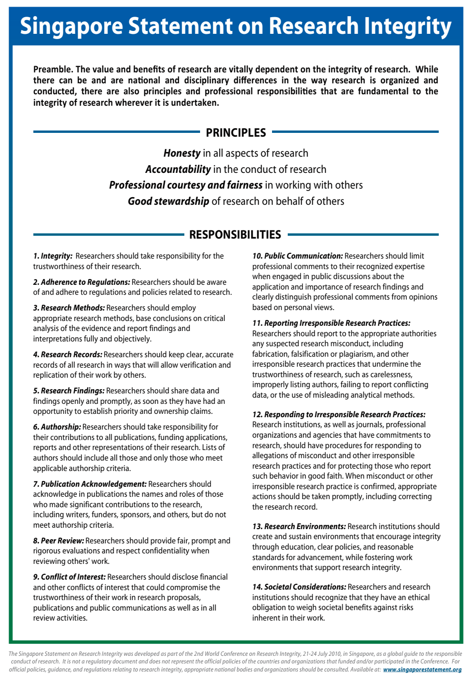
International guidelines
Singapore statement (2010)
Honesty in all aspects of research
Accountability in the conduct of research
Professional courtesy and fairness in working with others
Good stewardship of research on behalf of others
Montreal Statements, cross-Boundary collaborations (2013)
Integrity
Trust
Purpose
Goals
Hong Kong Principles, assessing researchers (2019)
Value complete reporting
Reward the practice of open science
Acknowledge a broad range of research activities
Recognize essential other tasks like peer review and mentoring
Global guides toward comprehensive standards, codes, policies but not regulatory documents
Consult your institutional policies, guidance, and regulations

Slide 8
European and French guidelines
European code of conduct for research integrity (2011 revised in 2017)
Reliability
Honesty
Respect
Accountability
French agencies
Office Français à l’intégrité scientifique, Haut Conseil pour l’évaluation de la Recherche et de l’enseignement supérieur (Hcéres)
https://www.hceres.fr/en/french-office-research-integrity
Agence National de la Recherche (ANR)
https://anr.fr/en/anrs-role-in-research/values-and-commitments/scientific-integrity/
Organismes de recherche
CNRS
https://www.cnrs.fr/en/research
Université de Montpellier
https://www.umontpellier.fr/recherche/charte-relative-a-lintegrite-scientifique
Inserm
https://www.inserm.fr/en/about-us/office-for-research-integrity/

Slide 9
Definition of integrity in research
https://h2020integrity.eu/integrity/
Active adherence to the regulatory and ethical principles and professional standards essential for the responsible conduct of research.
Planning of research
Conducting the research
Disseminating the results of the research

Slide 10
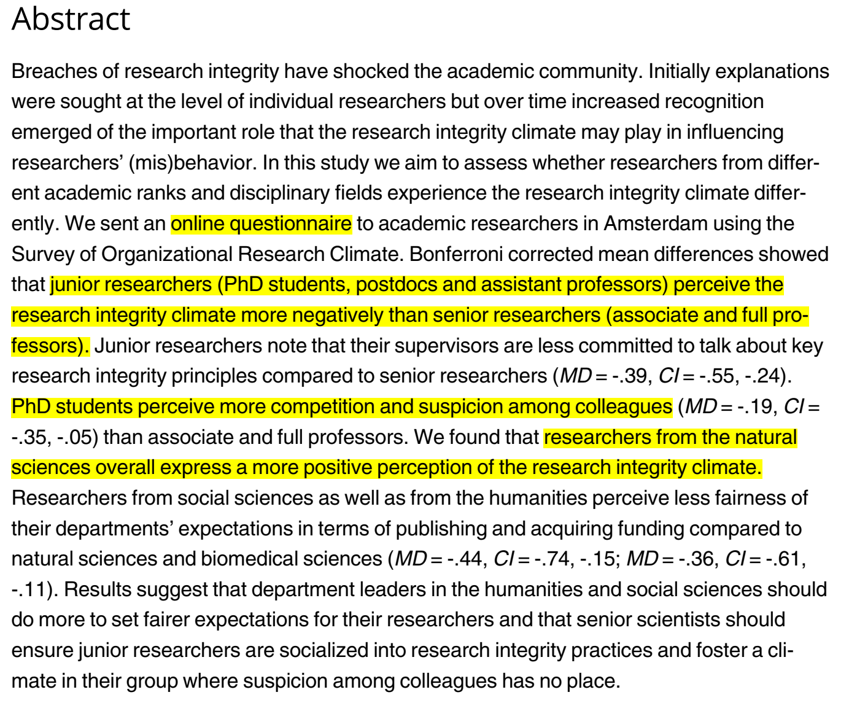
No universal definitions ?
Haven TL, Tijdink JK, Martinson BC, Bouter LM (2019) Perceptions of research integrity climate differ between academic ranks and disciplinary fields: Results from a survey among academic researchers in Amsterdam. PLoS ONE 14(1): e0210599. https://doi.org/10.1371/journal.pone.0210599

Slide 11
The serious violation of research integrity
FFP categorization
fabrication
falsification
plagiarism

Slide 12
The questionable research practices
The most frequent misconducts done to “improve” the outcome
to not consider contradictory results or to alter results
errors in statistics, calculations
modified pictures (photoshoped images)
undisclosed conflicts of interest (patents, company stock…)
lack of ethical approval or consents
excessive self-citations…
Different perception of misconducts depending upon
cultures
disciplines
positions
Grey area between licit, questionable and fraudulent practices

Slide 13
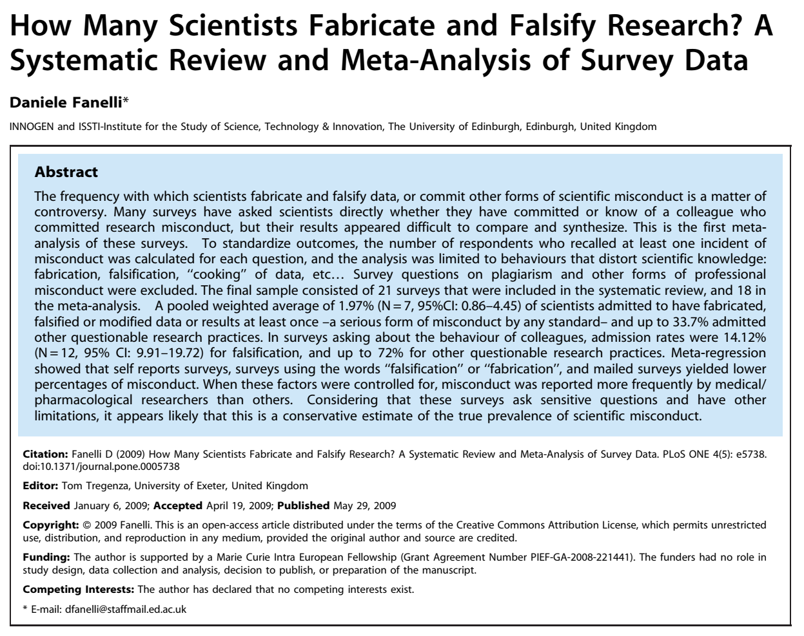
Frequency of research misconducts

Slide 14
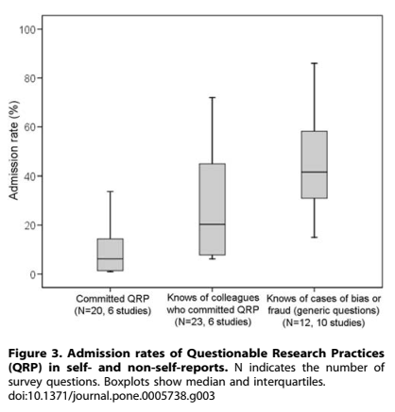
Frequency of research misconducts

Slide 15
Community sanctions against researchers
Associations, personnel investigations and so one…
(https://scienceintegritydigest.com/...)
PubPeer , The online journal club
https://pubpeer.com
The PubPeer Foundation is a California-registered public-benefit corporation with nonprofit status in the United States. The overarching goal of the Foundation is to improve the quality of scientific research by enabling innovative approaches for community interaction. The bylaws of the Foundation establish pubpeer.com as a service run for the benefit of its readers and commenters, who create its content. Our current focus is maintaining and developing the PubPeer online platform for post-publication peer review.

Slide 16
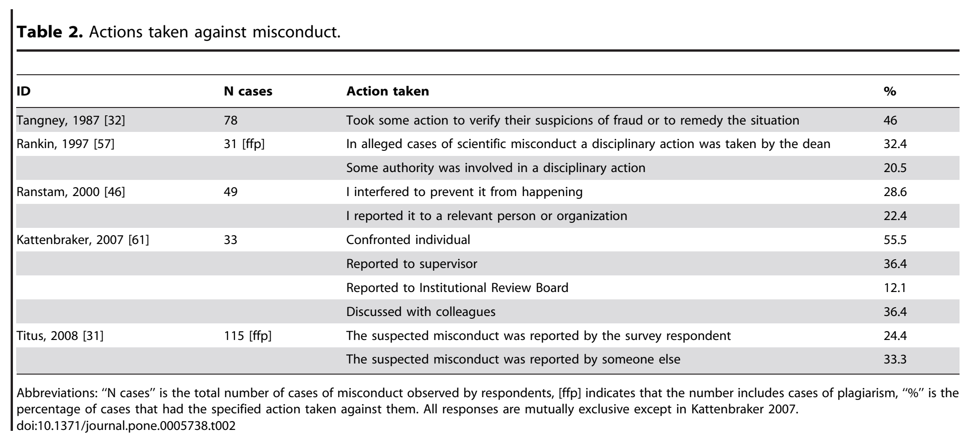
Institutional sanctions against researchers
Inserm, CNRS, Institut Pasteur : Rapport d’instruction à propos des signalements concernant dix publications de deux chercheurs travaillant à l’Institut Pasteur - 19 mars 2021
The Office of Research Integrity (US)

Slide 17
Institutional sanctions against laboratories
Case studies on Research Integrity, Dr M Lauer
May 2019 » The Role of Research Integrity in Promoting Excellence: Tools for Colleges and University Leaders”
https://youtu.be/ZKwpe77iZws?t=509

Slide 18
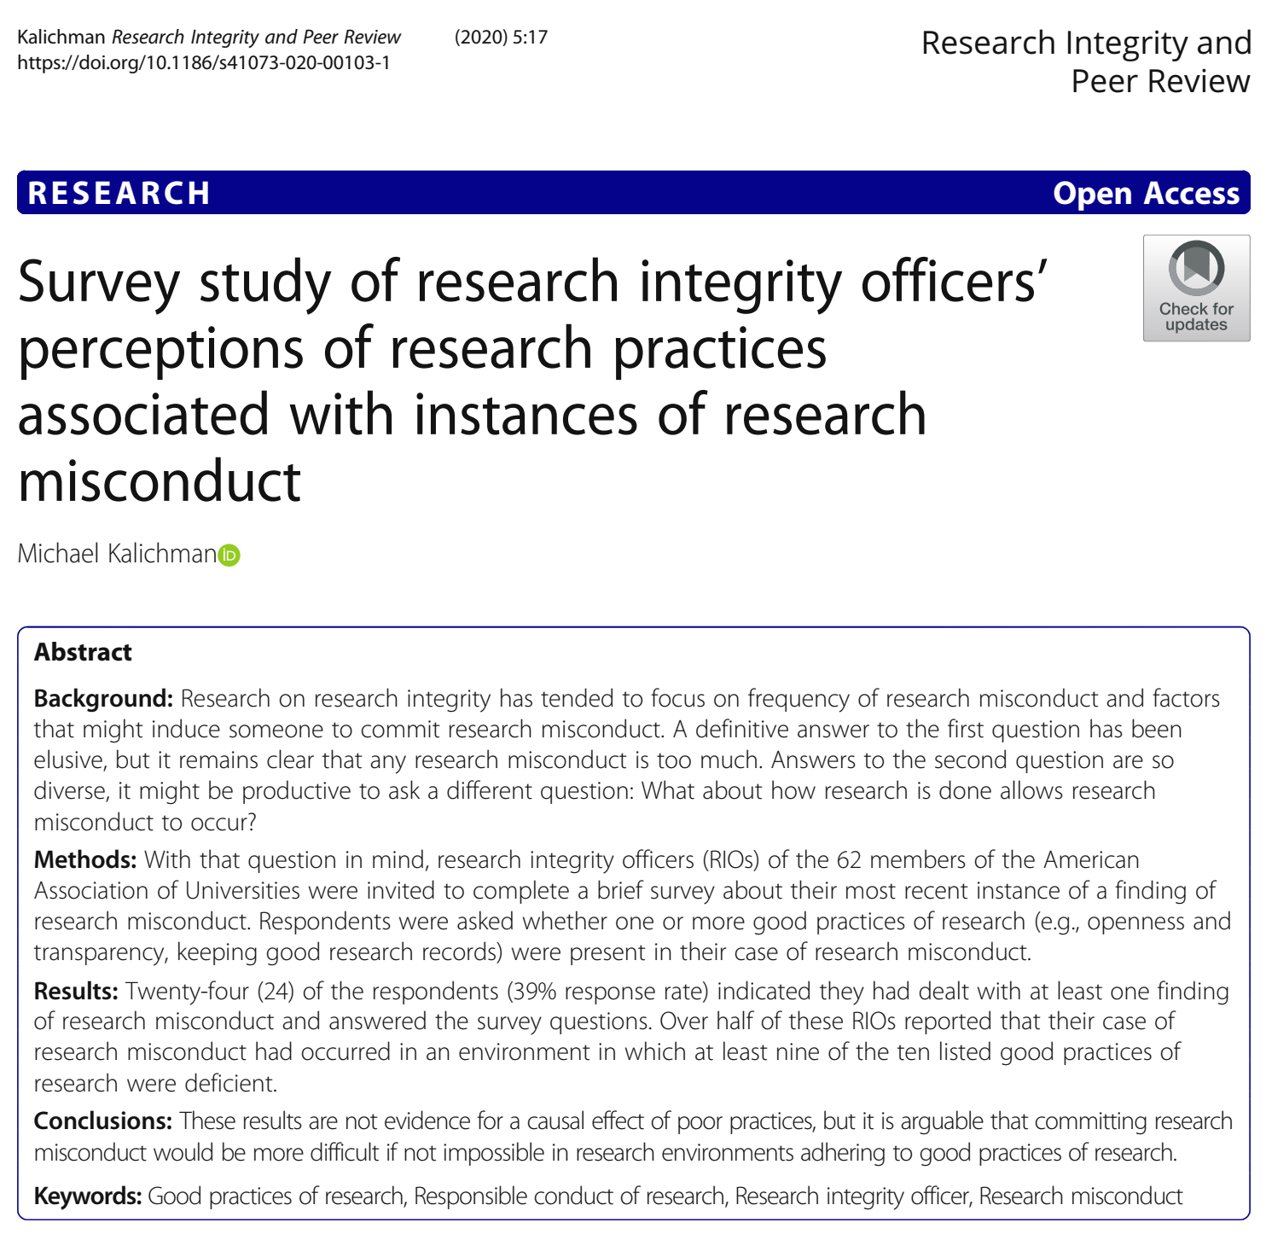
Why scientific misconduct?

Slide 19
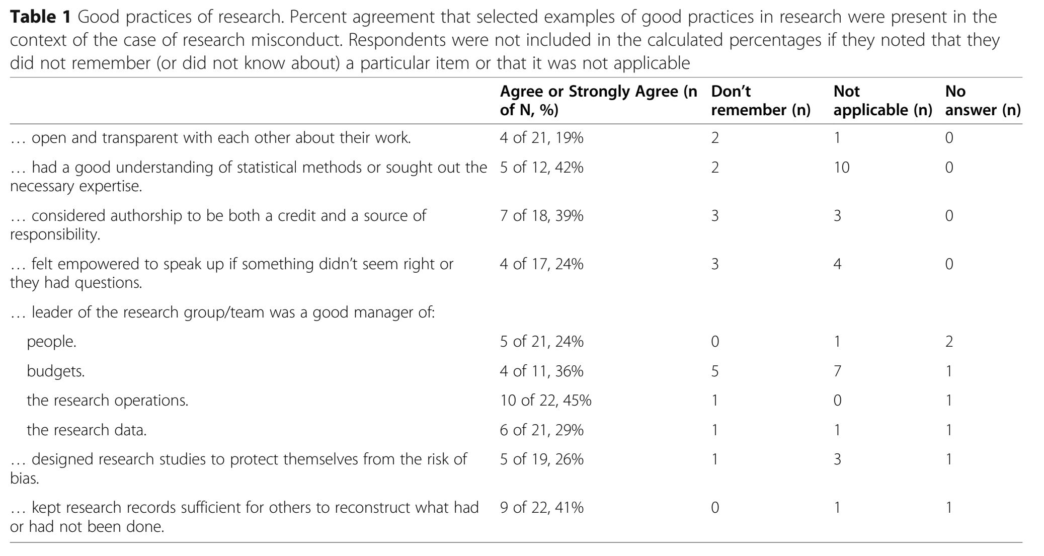
Why scientific misconduct?

Slide 20
(Not exhaustive) list of factors
Individual traits
vanity
rigor…
Cultural factors
difference in understanding what constitutes good scientific practice
Circumstances
financial
personal reasons…
Organizational factors
complex interpersonal relationships at the workplace
inadequate training or mentoring…
Structural elements (“publish-or-perish” culture)….
hyper-competitiveness
biases in peer-review and evaluation

Slide 21
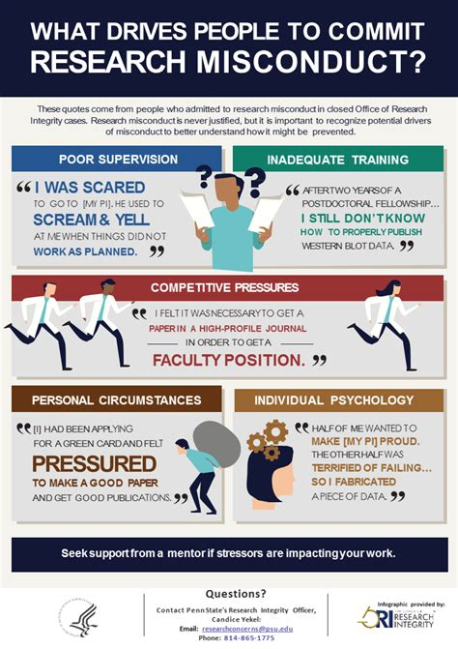
(Not exhaustive) list of factors

Slide 22
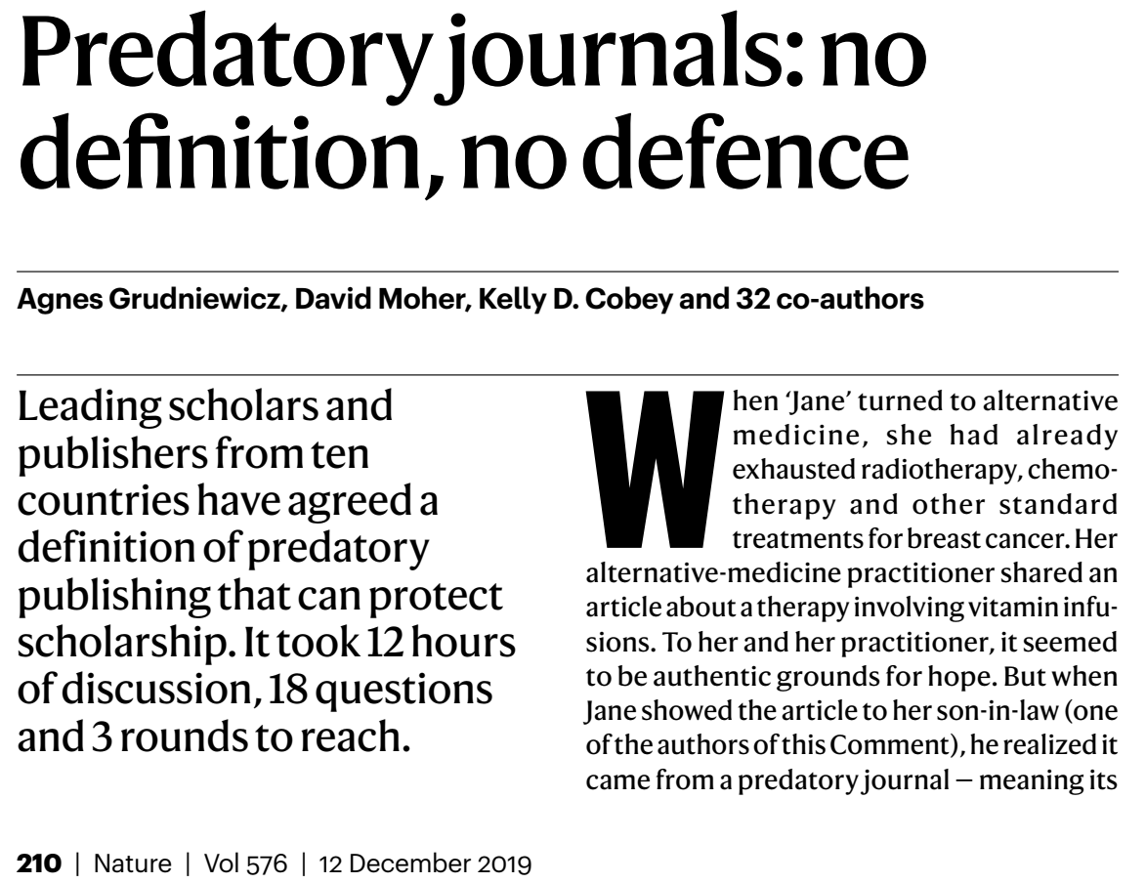
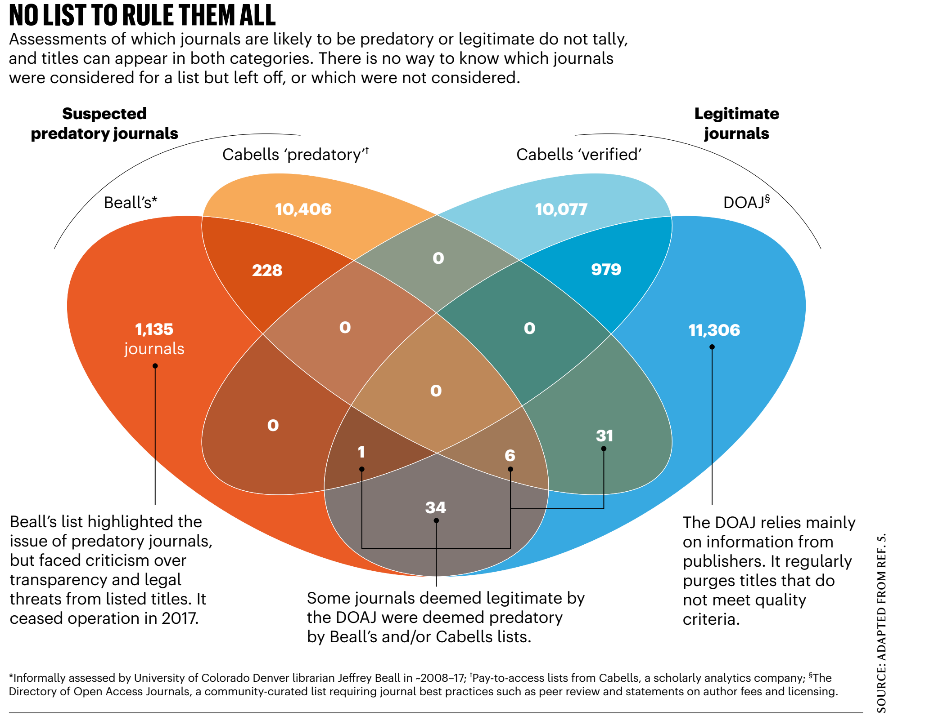
Predatory publishing and conferences

Slide 23
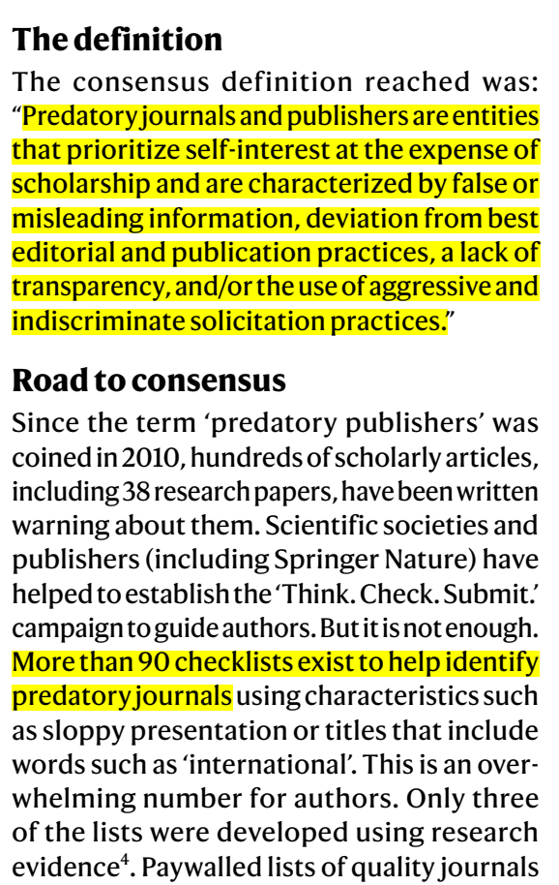
Predatory publishing and conferences

Slide 24
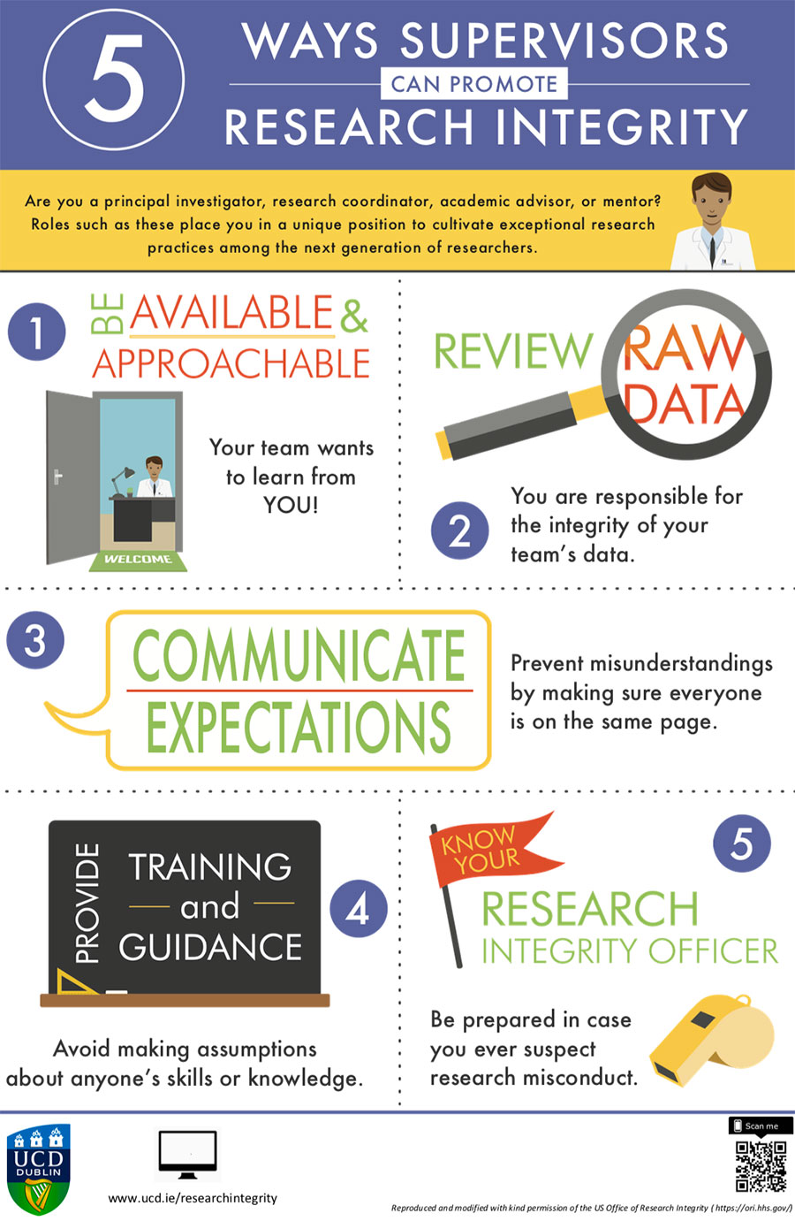
How to promote integrity / good practices?
Everyone’s responsability!
Supportive rather than controlling policies

Slide 25
How to promote integrity / good practices?
Everyone’s responsability!
Supportive rather than controlling policies
Institutional guidelines, information, diffusion and so one….
Please read some guides (European code of conduct for RI, CNRS guide)
to known what the society is expecting from you as a professional researcher!
National institutional initiatives
Office Français à l’intégrité scientifique (Hcéres)
https://www.hceres.fr/en/french-office-research-integrity
European Network of Research Integrity Office (ENRIO) http://www.enrio.eu/
US research integrity office https://ori.hhs.gov/
UK research integrity office https://ukrio.org/
Research programs….
https://sops4ri.eu/toolbox

